Slide 1

Building and Mining Knowledge graphs
(KEN4256)
Lecture 10: Retrieval Augmented Generation

Slide 2
© 2024 by Michel Dumontier and the Institute of Data Science at Maastricht University is licensed under Attribution 4.0 International
To view a copy of this license, visit http://creativecommons.org/licenses/by/4.0/
This license requires that reusers give credit to the creator. It allows reusers to distribute, remix, adapt, and build upon the material in any medium or format, even for commercial purposes.
id: KEN4256_L10
version: 1.2024.0
created: March 17, 2024
last modified: March 26, 2024
published on: March 26, 2024

Slide 3
Introduction
Retrieval Augmented Generation is a methodology by which a generative model (e.g. transformer-based neural network) is augmented with external knowledge retrieval. This helps address limitations in LLMs including factual accuracy, timeliness, and access to non-public knowledge.
External knowledge source could involve
web search
access to documents / databases / knowledge graphs
web services

Slide 4
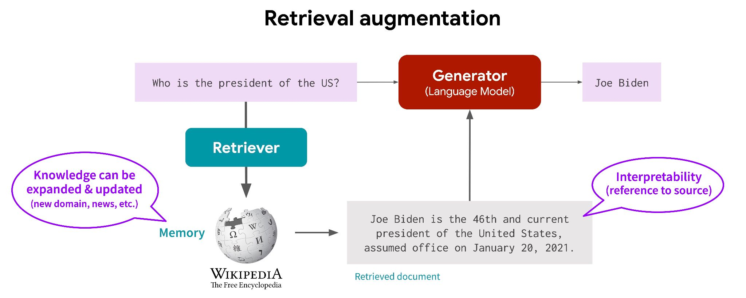
https://cs.stanford.edu/~myasu/blog/racm3/

Slide 5
Approach
docs
2
1
embed
docs
query
embed
query
retriever
vectordb
return k-relevant
documents
3
compose prompt
4
The user inputs a query, which is encoded and used to retrieve relevant documents. These documents, along with the original query, are then fed into the generator, which produces the final output.
return answer
llm

Slide 6
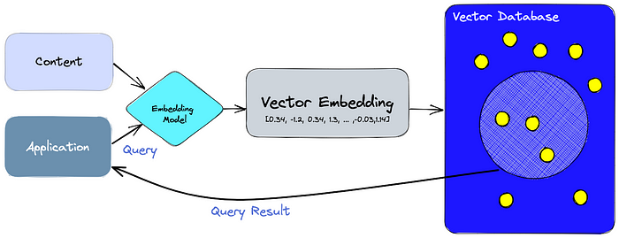
https://www.pinecone.io/learn/vector-database/

Slide 7
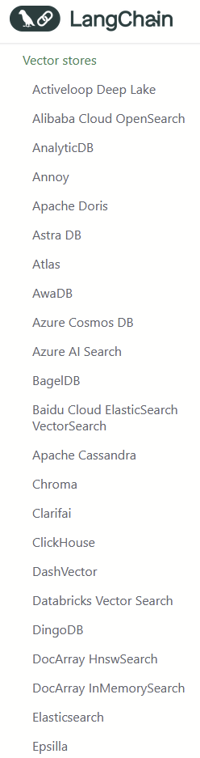
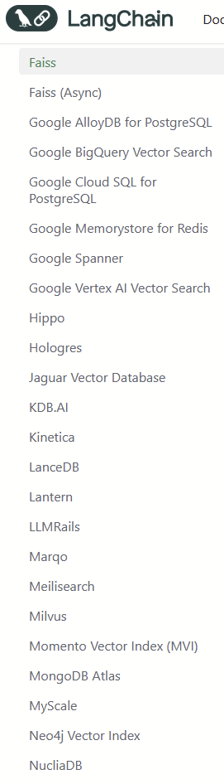
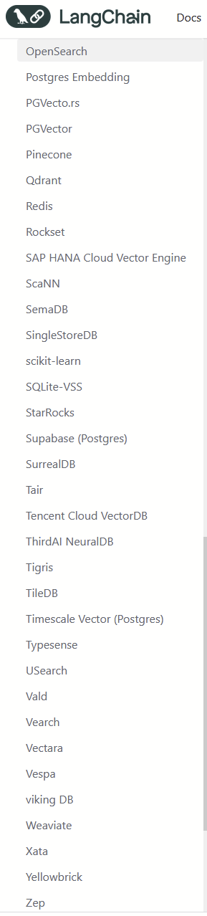
Features
self-hosted/managed
ranking algorithms
metadata filtering
indexing
access control
security/privacy certification (SOC, HIPPA, GDPR)

Slide 8
Methodology
The query encoder processes the input query to generate a representation suitable for retrieval.
The retriever uses this representation to fetch relevant documents or data from the database.
The document database is a pre-compiled collection of texts or knowledge that the retriever queries.
The generator then takes the original query along with the retrieved documents to generate a coherent and contextually enriched response.

Slide 9
Frameworks
LangChain (RAG)
Microsoft Semantic kernel
LlamaIndex (RAG, notebook)
llmware
LLM provisioning
Ollama - download models and serve them up via http
LlamaCpp
vLLM

Slide 10
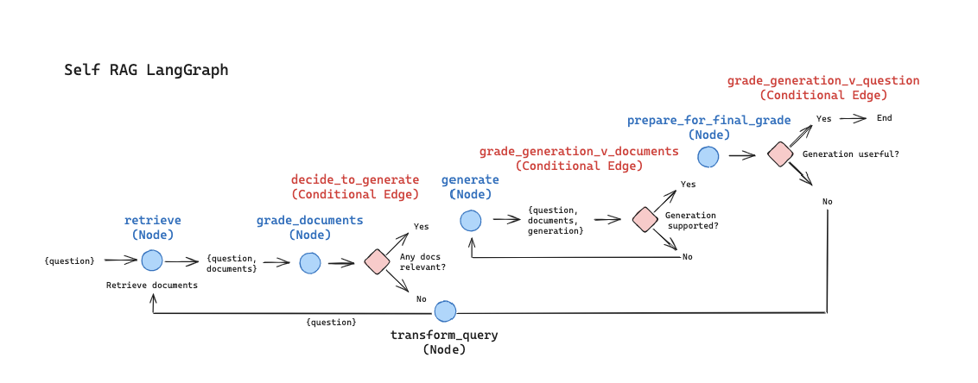
Langgraph
LangGraph is a library for building stateful, multi-actor applications with LLMs, built on top of (and intended to be used with) LangChain. It extends the LangChain Expression Language with the ability to coordinate multiple chains (or actors) across multiple steps of computation in a cyclic manner. https://github.com/langchain-ai/langgraph
The main use is for adding cycles to your LLM application. Crucially, this is NOT a DAG framework. If you want to build a DAG, you should just use LangChain Expression Language.
Cycles are important for agent-like behaviors, where you call an LLM in a loop, asking it what action to take next.

Slide 11
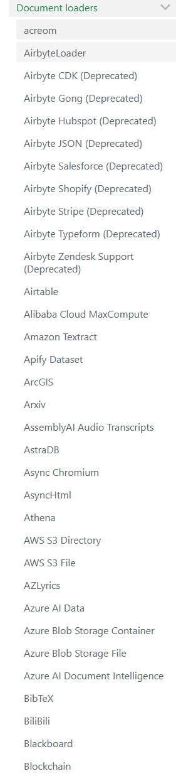
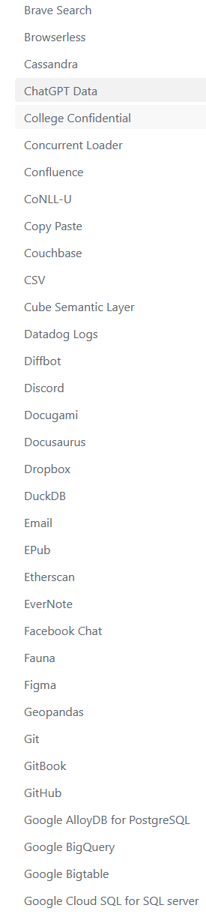
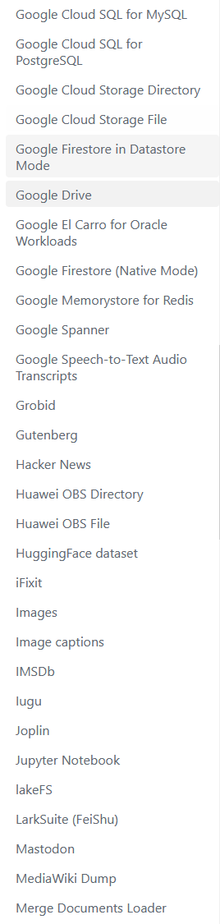
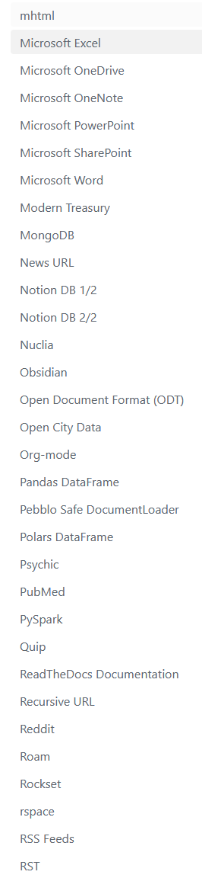
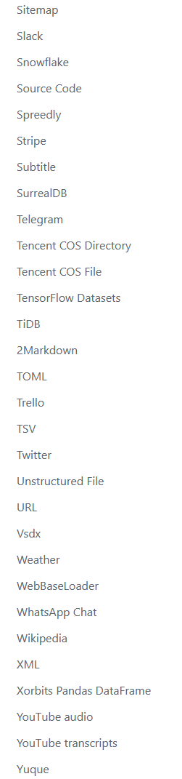
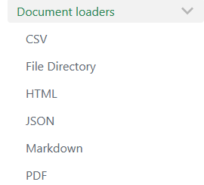
Document loaders
First step is to load a collection of documents for processing. Many integrations available.

Slide 12
Text Splitting
We will need to split the documents into chunks that facilitate the retrieval of a sufficiently large context to help answer the question but can also fit into the llm context window.
Split by:
# of tokens, character, sentence, paragraph
document structure (e.g. HTML headers)
semantic structure
multi-vector indexing
see notebook

Slide 13
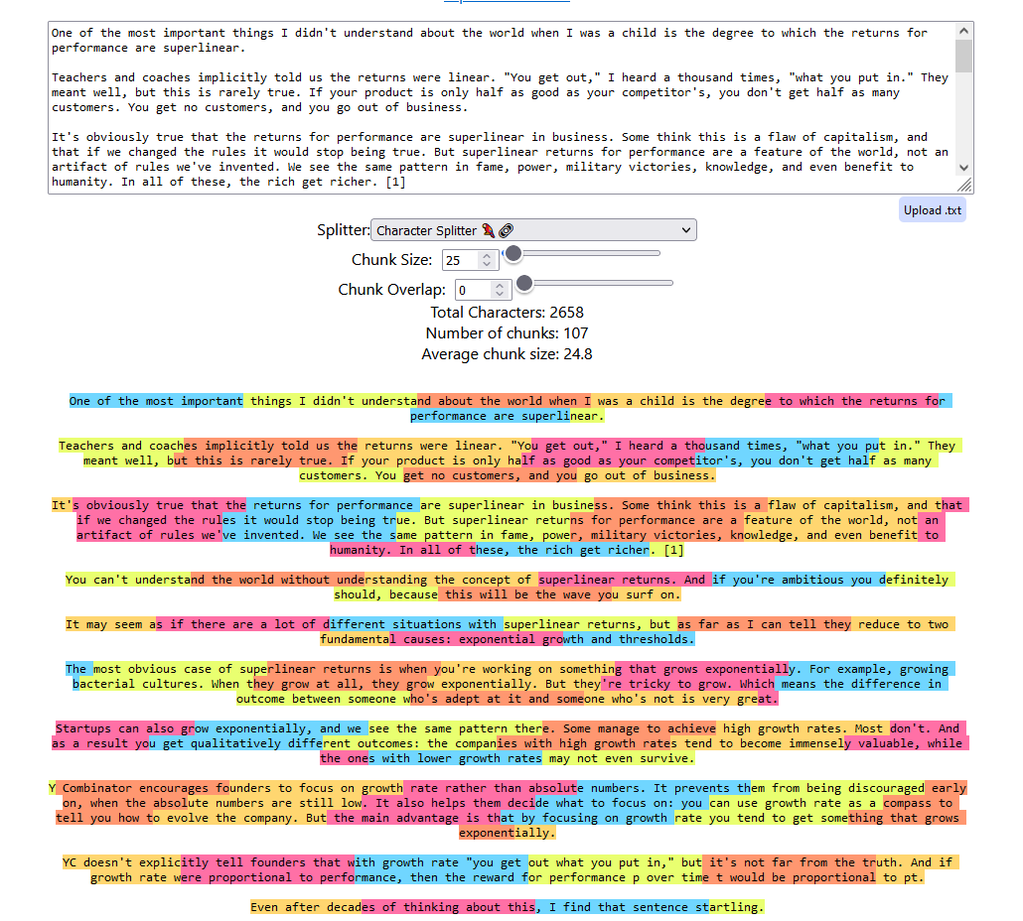
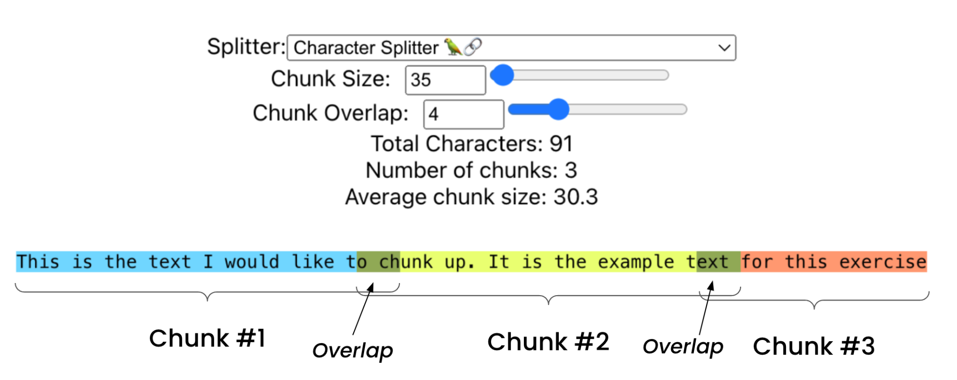
https://chunkviz.up.railway.app

Slide 14
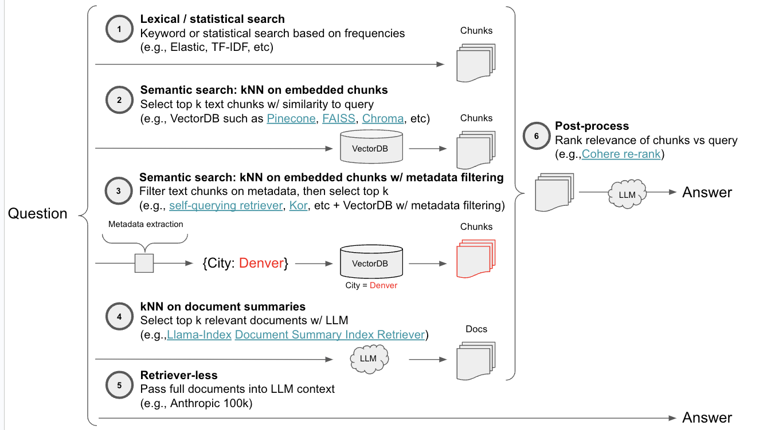
https://github.com/langchain-ai/auto-evaluator/tree/main/streamlit

Slide 15
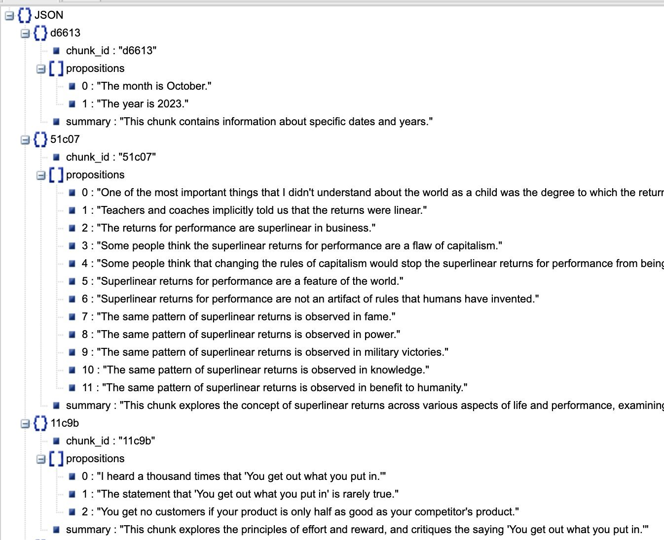
AgenticChunker
1. Get propositions
2. For each proposition, ask the LLM, should this be in an existing chunk or a make a new one?

Slide 16
Multi-vector Indexing
semantic search for a vector that is derived from something other than the raw text
summary
hypothetical questions
parent document
use LLM to generate a summary of the full document, which can be indexed for retrieval.
"The document discusses the concept of superlinear returns for performance, where the rewards for performance are not proportional to the effort put in. It explains that this concept is present in various aspects of life, such as business, fame, power, military victories, and benefit to humanity....
use LLM to generate hypothetical questions that would best match the document.
["What was the author's first experience with programming like?",
'Why did the author switch their focus from AI to Lisp during their graduate studies?',
'What led the author to contemplate a career in art instead of computer science?']
do search against smaller document fragments, and retrieve the parent document section for fuller context.

Slide 17
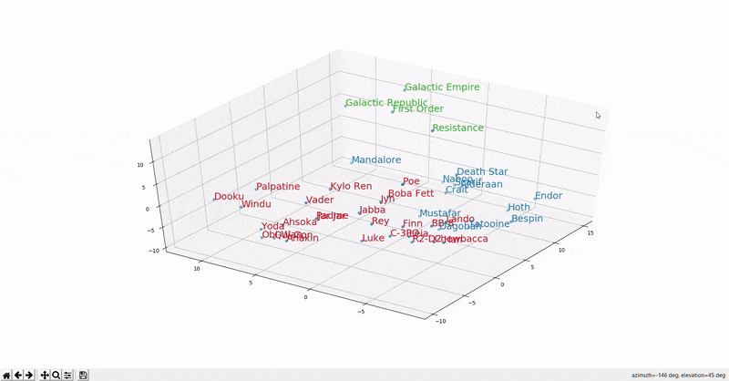
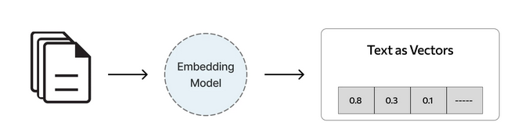
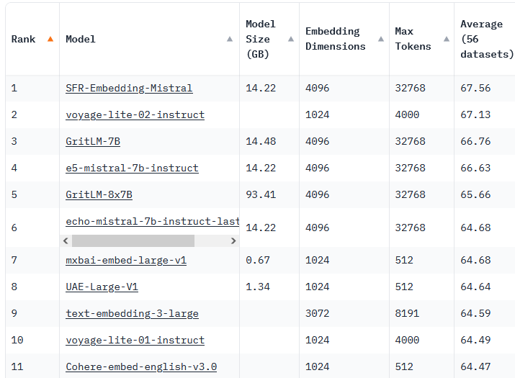
Text Embedding
The next step is to embed the text. Use sentence and document embedding models.
Sentence Transformers library is a Python framework for sentence, text and image embeddings. Gives you access to embedding models on hugging face.
"sentence-transformers/all-MiniLM-L6-v2" maps sentences & paragraphs to a 384 dimensional dense vector space and can be used for tasks like clustering or semantic search. It is very small (0.09GB), currently #75 on leaderboard
bge-small-en-v1.5 (0.13GB) currently #29, supported in FastEmbed python library.
Massive Text Embedding Benchmark (MTEB) https://huggingface.co/spaces/mteb/leaderboard

Slide 18
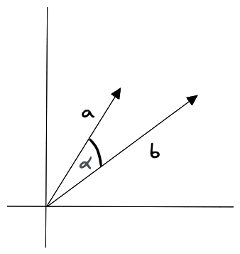
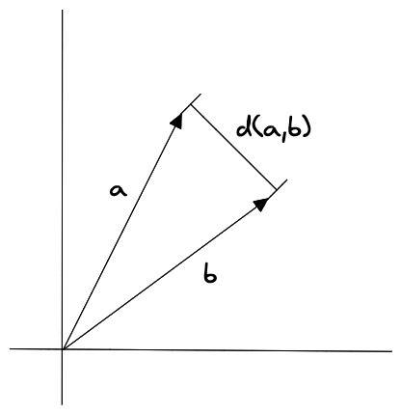
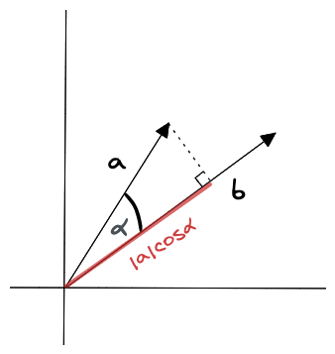
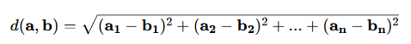
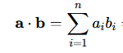
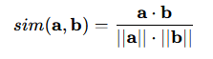
similarity measures
Euclidean distance
dot product
cosine similarity

Slide 19
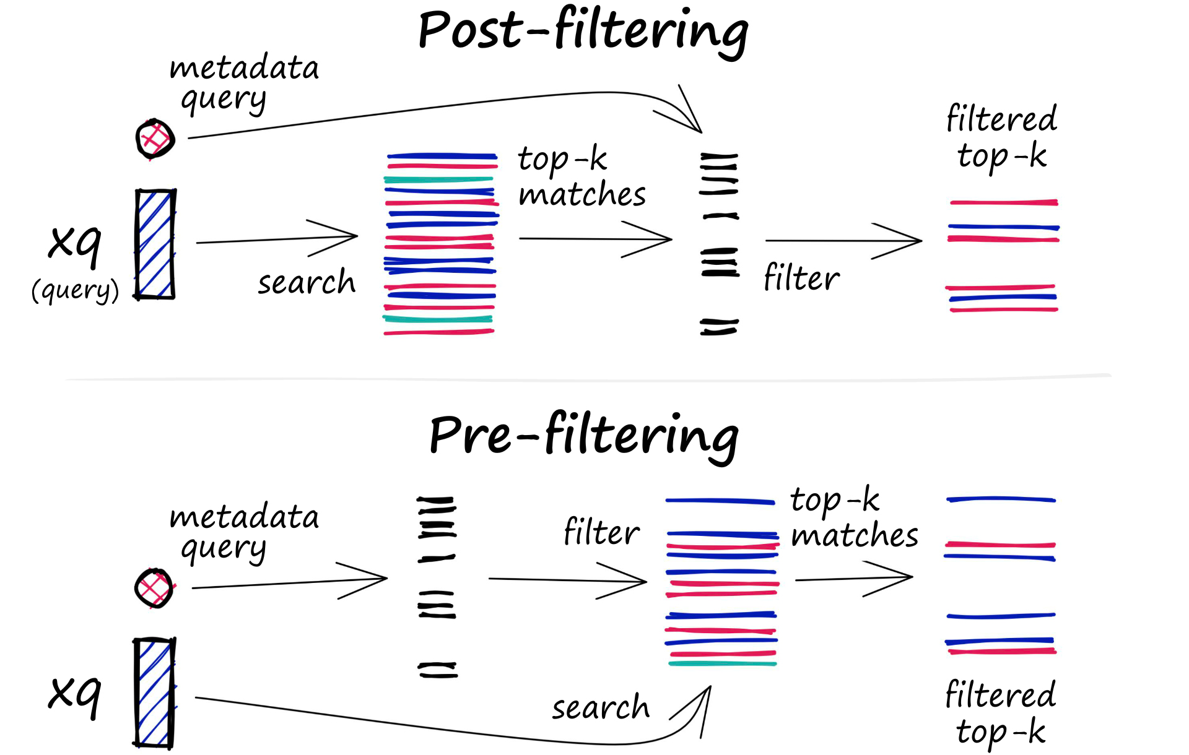
metadata filtering (aka self-querying)
The retriever can query the knowledge source and filter document metadata

Slide 20
RAG over RDF Graphs
Generate labels with URIs for indexing & retrieval.
Further customization is done by code.
LangChain (cf. docs: RAG with memory, streaming RAG)
FastEmbed embeddings
Qdrant vectorstore
LlamaCpp inference library
Mixtral 8x7B LLM
https://github.com/vemonet/langchain-rdf/blob/main/tests/rag_ontology.ipynb

Slide 21
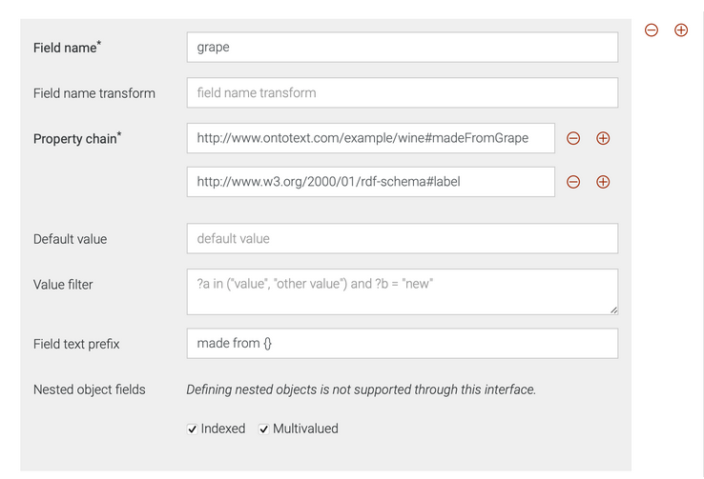
KG retriever (Ontotext graphdb)
Generates a text representation from the RDF graph.
Create rules for the retriever that are inserted and executed from the KG.
wine:Franvino
rdf:type wine:RedWine ;
wine:madeFromGrape wine:Merlo ;
wine:madeFromGrape wine:CabernetFranc ;
wine:hasSugar "dry" ;
wine:hasYear "2012"^^xsd:integer ;
wine:hasWinery "Semantinos" .
Franvino:
- is a RedWine.
- made from grape Merlo.
- made from grape Cabernet Franc.
- has sugar dry.
- has year 2012.
https://graphdb.ontotext.com/documentation/10.6/retrieval-graphdb-connector.html

Slide 22
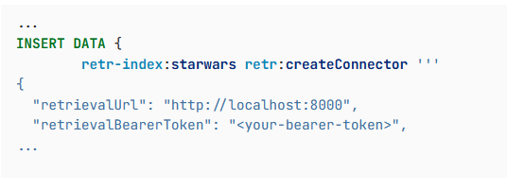
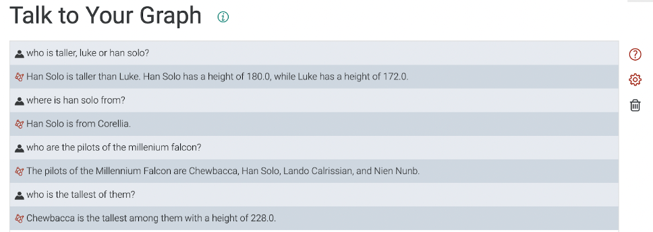
https://graphdb.ontotext.com/documentation/10.6/talk-to-graph.html

Slide 23
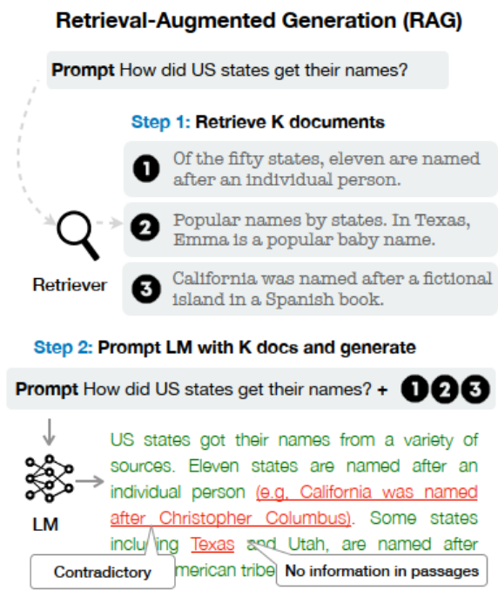

Slide 24
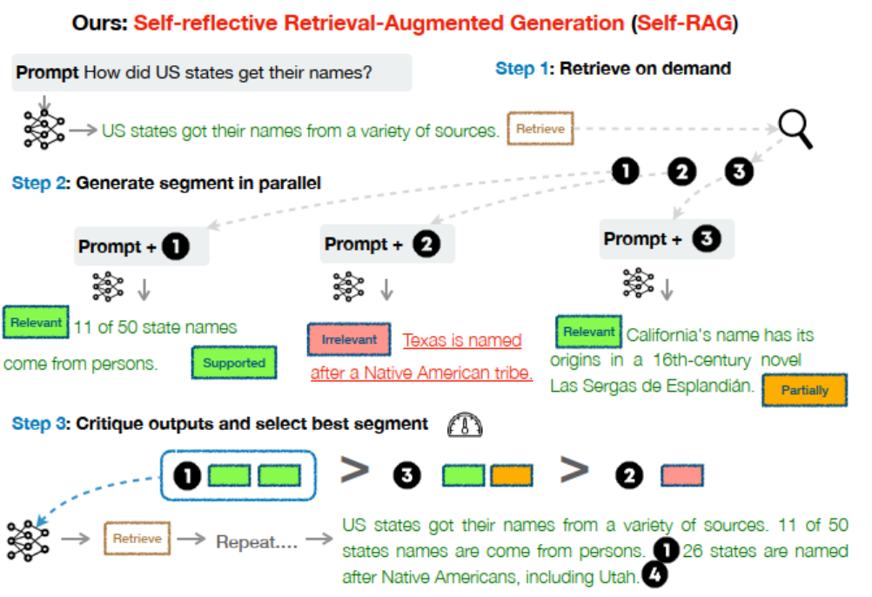
https://arxiv.org/abs/2310.11511
langchain notebook

Slide 25
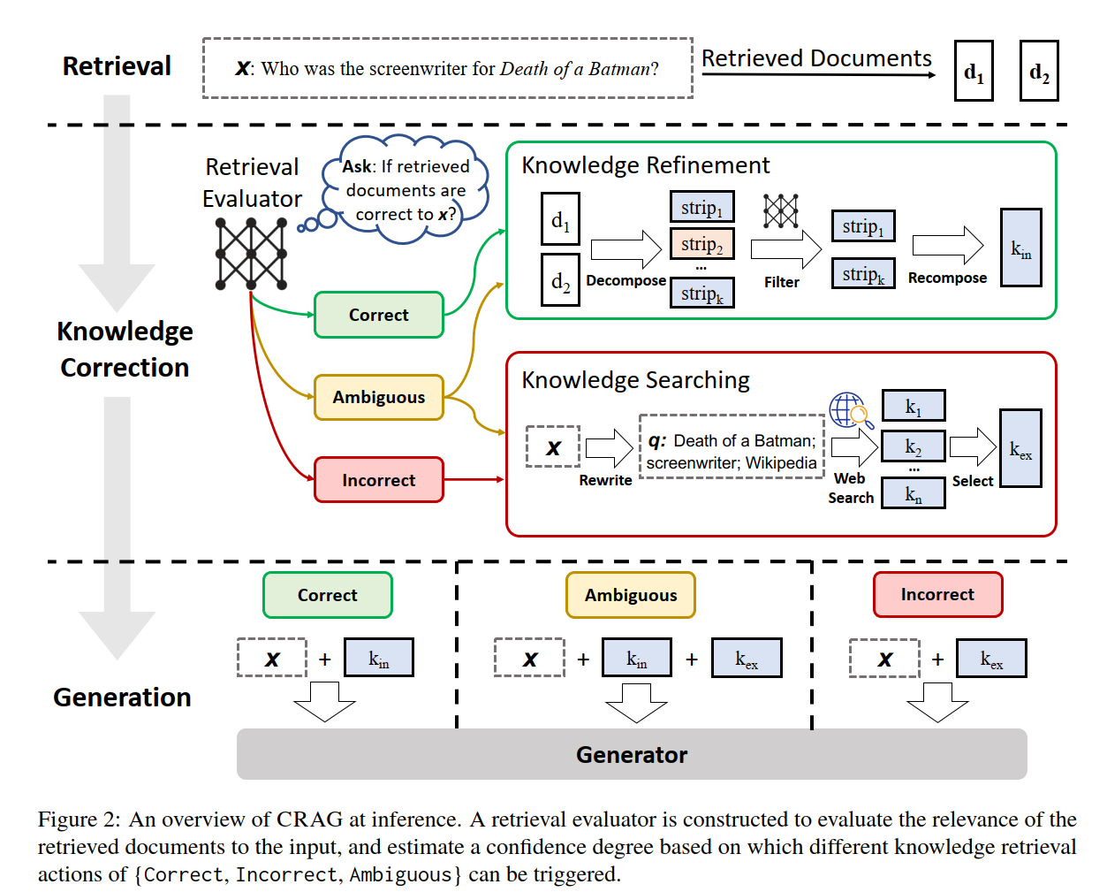
Corrective Retrieval Augmented Generation (CRAG)
langchain notebook
https://arxiv.org/abs/2401.15884

Slide 26
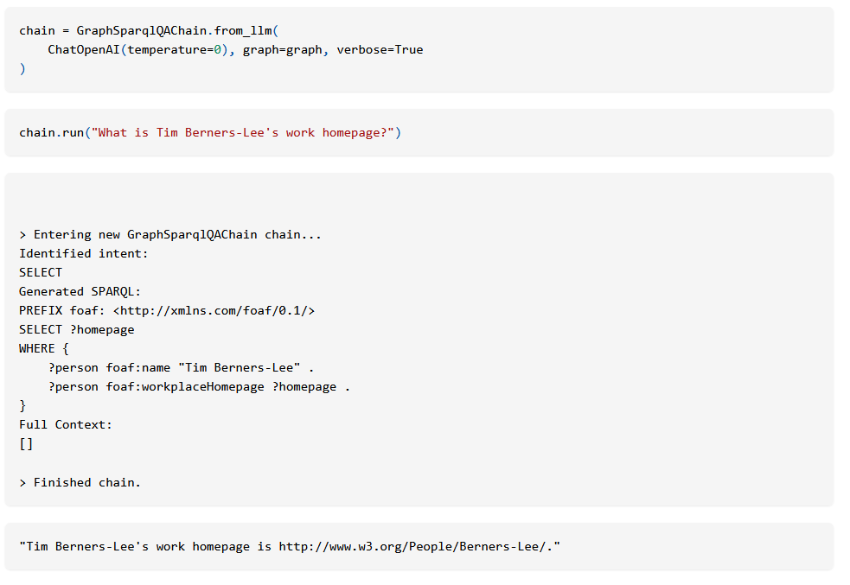
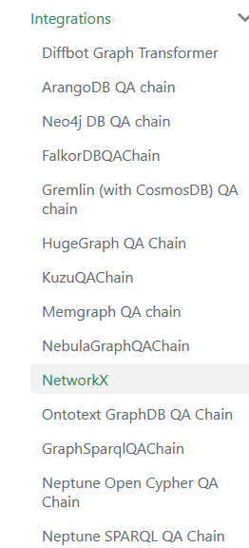
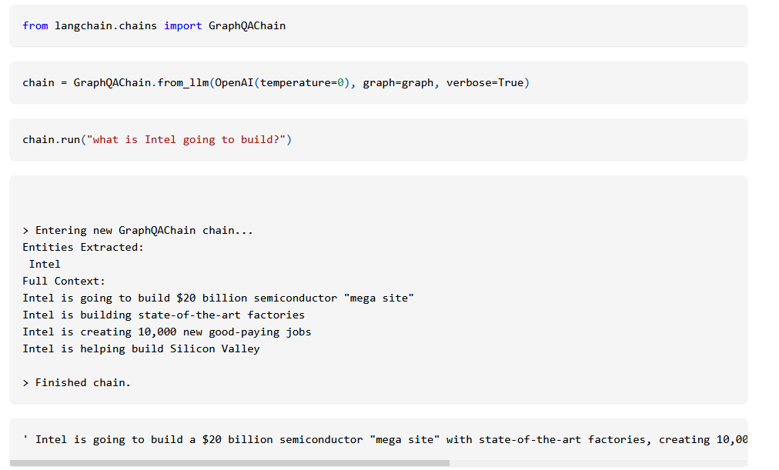
GraphDB Connectors
Translate user input into structured queries using the LLM

Slide 27
Summary
Retrieval Augmented Generation (RAG) is a powerful technique that uses external knowledge sources to augment the capabilities of a Large-Large Model.
There are many factors to consider in the development of the pipeline including
document chunking strategies
embedding model selection
vector database selection
relevancy and corrective techniques
KGs can also be embedded into vectorDBs, with strategies needed to retrieve fragments across the graph span.

